Slide 1
Lightning Talk: Phonetic drift
Ben Lang

Slide 2
The Problem
Phonetic drift occurs when a person’s native language is affected by their second language
This makes an individual sound less native in their first language
This tends to occur in people that have heavy second language contact
e.g. American expats in Paris, France
Language occupies a shared space for a given individual

Slide 3
The Data
Lang & Davidson, in review.
Recorded from actual subjects in Paris, France
Study Abroad Group
Paris Resident Group
French Group
Data are categorized by subject, language, vowel, word, F1, F2, F3, comments, and consonant context
Focus point: F1 and F2 for each vowel in each language

Slide 4
The Hypothesis
Do American expats living in France belong to the group of native English speakers or the group of native French speakers?
Successful results: American expats trend away from English and trend towards French
It’s not likely that they have completely shifted over to French
Alternative results: American expats maintain no effect of their French on their English

Slide 5
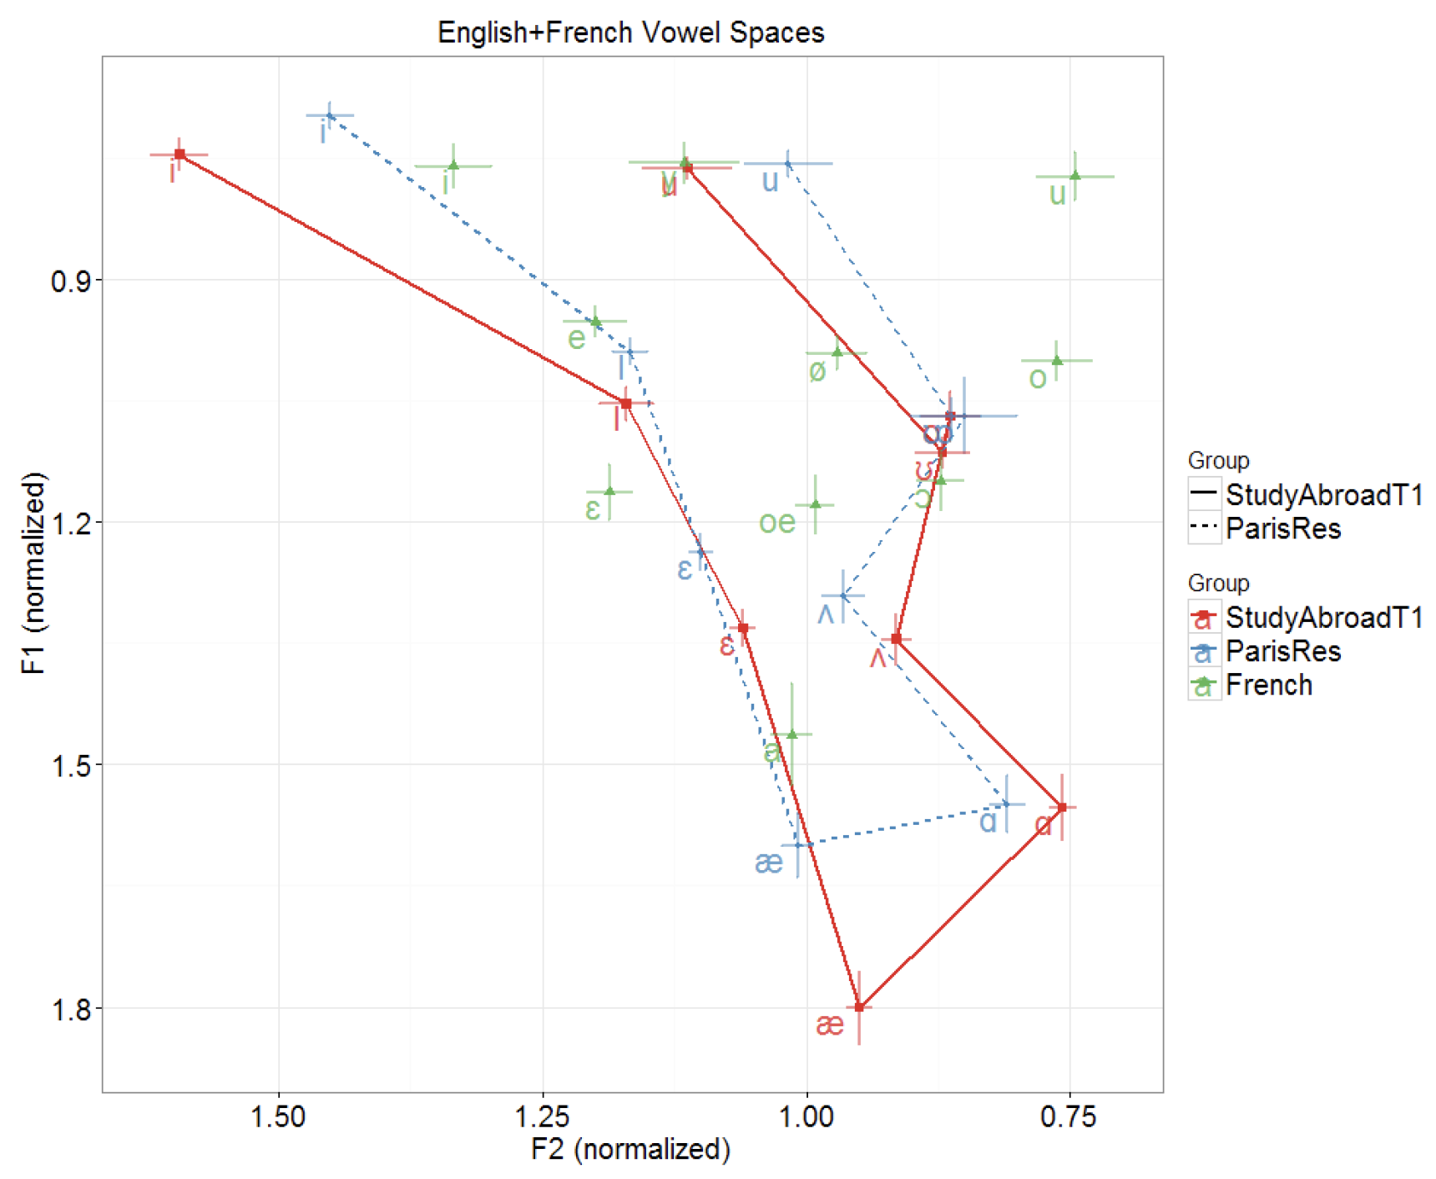

Slide 6
Other Options
Can the time of year predict the likelihood of a large earthquake in a certain area?
Are vegan and vegetarian restaurants more likely to be on the East Coast or West Coast?

